Slide 1

PYNQ101 – Intro to PYNQ
Presented By: Noah Garcia

Slide 2
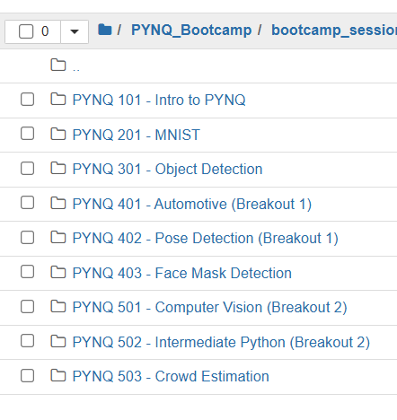
JupyterLab

Slide 3
Using JupyterLab
JupyterLab is a cell-based GUI (graphical user interface) that allows you to develop and document code incrementally
It is super helpful for prototyping and developing programs
We will be using it throughout the bootcamp for PYNQ
The basic components we will be using are:
Markdown cells
Code cells
We can interact with the KV260 boards using Python code

Slide 4
Using Variables
Computers need very specific instructions and that includes telling them when, where, and what we want them to remember.
Memory
counter = 0
Counter: 1
counter = counter + 1
Counter: 0
Index: 2
Index = 2

Slide 5
Using Lists
Lists are a collection of variables all stored together. They are accessed using an index, which starts at 0.
words = [“monkey”, “dolphin”, “cat”, “lion”]
Memory
words[1] would be “dolphin”
monkey
dolphin
cat
lion
words[0]
words[1]
words[2]
words[3]

Slide 6
Using If Statements
If statements allow a computer to make decisions based on what is input or what it has in memory.
if words[0] == “monkey”:
print(“True!”)
else:
print(“False ☹”)
Memory
monkey
dolphin
cat
lion
words[0]
words[1]
words[2]
words[3]
True!

Slide 7
Using For Loops
For Loops allow us to repeat operations multiple times.
0
I’m repeating!
for number in [0, 1, 2, 3]:
print(number)
print("I'm repeating!")
1
I’m repeating!
2
I’m repeating!
3
I’m repeating!

Slide 8
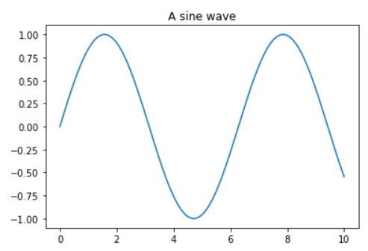
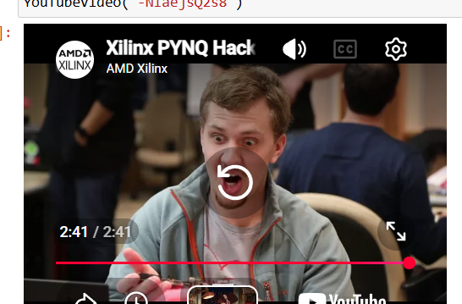
Using Libraries
Developers like to share code with each other, and this is done through libraries. They help save time since we can reuse code and develop technology further through collaboration. This is what you will be doing with PYNQ! Some examples of what you can do with a library are shown here:

Slide 9
Level Up: The FPGA & the DPU
How a Python library can rewire your chip into an AI accelerator

Slide 10
Where the magic happens: hardware libraries
SOFTWARE library
Our code has been running on the board's CPU — just like a laptop.
But underneath sits re-programmable hardware called an FPGA.
Some libraries (overlays) don't just run code — they rewire the chip.
CPU (the board's regular processor)
changes what your
code DOES
HARDWARE library (overlay)
CPU
runs your
Python
FPGA
does the
heavy work
the overlay adds an FPGA circuit → changes what your chip IS

Slide 11
What is an FPGA?
FPGA = box of LEGO circuits
build many workers, all at once
FPGA = Field-Programmable Gate Array.
A CPU is like one fast chef doing steps in order.
An FPGA is a box of LEGO for circuits — build many parallel workers.
"Field-programmable" = rebuild it anytime, even inside your board.
many workers, in parallel
CPU = one very fast chef
does steps one after another
Step 1
Step 2
Step 3
one worker, in order

Slide 12
So what is a DPU?
DPU = Deep-learning Processing Unit — a circuit we build inside the FPGA.
Its job: run neural networks (the brains behind AI) super fast.
It's not a separate chip — it's a design we LOAD with a Python library.
DPU inside the FPGA
a factory for AI math
a photo
goes in
the answer
comes out:
"school bus!"

Slide 13
Building a DPU in 3 lines of Python
Import the tools, rewire the FPGA, then give it a trained AI model.
The .bit file is the "LEGO instructions"; .xmodel is the AI brain.
Finally grab the runner — your remote control for the DPU.
1
2
3
▶
import
DpuOverlay
DpuOverlay
("dpu.bit")
load_model
(".xmodel")
overlay
.runner
get the tools
rewire the FPGA
give it an AI brain
grab the remote

Slide 14
The big takeaway
SOFTWARE
changes what your code DOES
HARDWARE
changes what your chip IS
Real AI projects use BOTH: a little Python on the CPU + a DPU doing the heavy lifting in the FPGA

